Slide 1
SCRUM

Slide 2
SCRUM
With acknowledgement to mike cohn from mountain goat software, llc
Notes:
Origins:
Jeff Sutherland
Initial scrums at Easel Corp in 1993
IDX and 500+ people doing Scrum
Ken Schwaber
ADM
Scrum presented at OOPSLA 96 with Sutherland
Author of three books on Scrum
Mike Beedle
Scrum patterns in PLOPD4
Ken Schwaber and Mike Cohn
Co-founded Scrum Alliance in 2002, initially within the Agile Alliance

Slide 3

We’re losing the relay race
“The… ‘relay race’ approach to product development…may conflict with the goals of maximum speed and flexibility. Instead a holistic or ‘rugby’ approach—where a team tries to go the distance as a unit, passing the ball back and forth—may better serve today’s competitive requirements.”
Hirotaka Takeuchi and Ikujiro Nonaka, “The New New Product Development Game”, Harvard Business Review, January 1986.
Notes:
would be nice to include a quote from Wicked Problems here

Slide 4
Scrum in 100 words
Scrum is an agile process that allows us to focus on delivering the highest business value in the shortest time.
It allows us to rapidly and repeatedly inspect actual working software (every two weeks to one month).
The business sets the priorities. Teams self-organize to determine the best way to deliver the highest priority features.
Every two weeks to a month anyone can see real working software and decide to release it as is or continue to enhance it for another sprint.

Slide 5

Scrum origins
Jeff Sutherland
Initial scrums at Easel Corp in 1993
Ken Schwaber
Scrum presented at OOPSLA 95 with Sutherland
Mike Beedle
Scrum patterns in PLOPD4
Ken Schwaber and Mike Cohn
Co-founded Scrum Alliance in 2002

Slide 6
SCRUM has been used
Microsoft
Yahoo
Google
EA
Siemens
Nokia
Intuit
Saleforce.com
Embedded systems
24x7 systems
Video games
FDA approved systems
Websites
Mobile phones
Network switching
Joint Strike Fighter

Slide 7
Characteristics
Self-organizing teams
Product progresses in a series of month-long “sprints”
Requirements captured in “product backlog”
No specific engineering practices prescribed
Uses generative rules to create an agile environment for delivering projects

Slide 8
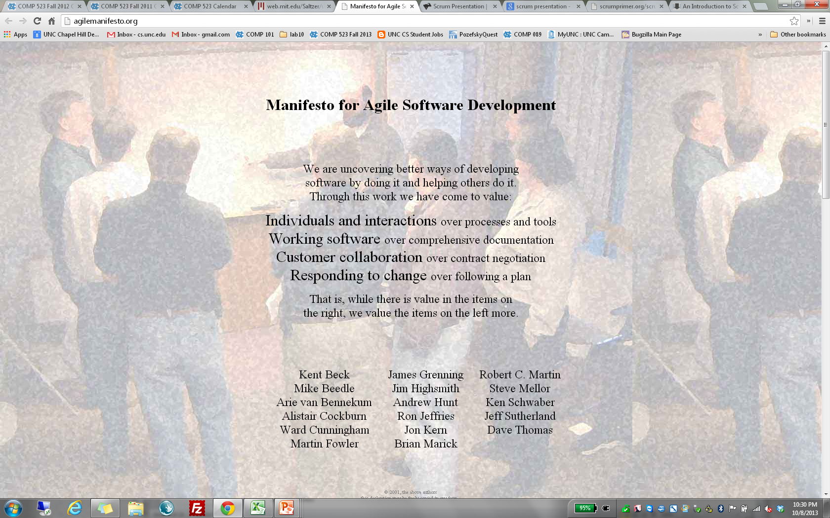

Slide 9

Project noise level
Far from
Agreement
Anarchy
Complex
Requirements
Complicated
Source: Strategic Management and Organizational Dynamics by Ralph Stacey in Agile Software Development with Scrum by Ken Schwaber and Mike Beedle.
Simple
Close to
Agreement
Technology
Close to
Certainty
Far from
Certainty

Slide 10
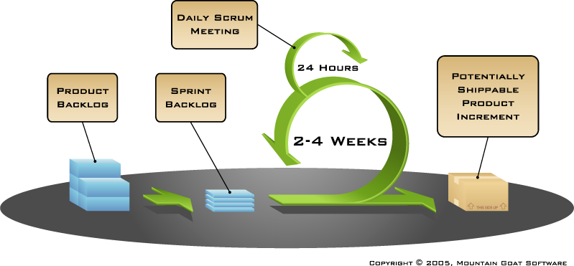
The Process
© www.mountaingoatsoftware.com/scrum

Slide 11
Sprints
Scrum projects make progress in a series of “sprints”
Typical duration is 2–4 weeks or a calendar month at most
A constant duration leads to a better rhythm
Product is designed, coded, and tested during the sprint

Slide 12

Sequential vs. overlapping development
Requirements
Design
Code
Test
Rather than doing all of one thing at a time...
...Scrum teams do a little of everything all the time
Source: “The New New Product Development Game” by Takeuchi and Nonaka. Harvard Business Review, January 1986.

Slide 13
Unified (Software Development) Process
Iterations within phases
4 phases and core workflows for each
Inception
Elaboration
Construction
Transition
Requirements
Analysis
Design
Implementation
Test

Slide 14


No changes during a sprint
Change
Plan sprint durations around how long you can commit to keeping change out of the sprint

Slide 15
Scrum framework
Roles
Product owner
ScrumMaster
Team
Ceremonies
Sprint planning
Sprint review
Sprint retrospective
Daily scrum meeting
Artifacts
Product backlog
Sprint backlog
Burndown charts

Slide 16

Product owner
Define the features of the product
Decide on release date and content
Be responsible for the profitability of the product (ROI)
Prioritize features according to market value
Adjust features and priority every iteration, as needed
Accept or reject work results

Slide 17

The ScrumMaster
Represents management to the project
Responsible for enacting Scrum values and practices
Removes impediments
Ensure that the team is fully functional and productive
Enable close cooperation across all roles and functions
Shield the team from external interferences

Slide 18





The team
Typically 5-9 people
Cross-functional:
Programmers, testers, user experience designers, …
Members should be full-time
May be exceptions (e.g., database administrator)
Teams are self-organizing
Membership should change only between sprints

Slide 19


Team capacity
Sprint planning meeting
Sprint prioritization
Product backlog
Sprint
goal
Analyze and evaluate product backlog
Select sprint goal
Business conditions
Sprint planning
Decide how to achieve sprint goal (design)
Create sprint backlog (tasks) from product backlog items (user stories / features)
Estimate sprint backlog in hours
Current product
Sprint
backlog
Technology

Slide 20
Sprint planning
Team selects items from product backlog they can commit to
Sprint backlog is created
Tasks are identified and each is estimated (1-16 hours)
Collaboratively, not done alone by the ScrumMaster
High-level design is considered
As a vacation planner, I want to see photos of the hotels.
Code the middle tier (8 hours)
Code the user interface (4)
Write test fixtures (4)
Code the foo class (6)
Update performance tests (4)

Slide 21
The daily scrum
Daily
15-minutes
Stand-up
Not for problem solving
Whole world is invited
Only team members, Scrum Master, product owner talk
Helps avoid other unnecessary meetings

Slide 22

Everyone answers 3 questions
1
What did you do yesterday?
2
What will you do today?
3
Is anything in your way?
not status for the ScrumMaster
commitments in front of peers

Slide 23
A sample product backlog
Backlog item | Estimate
Allow a guest to make a reservation | 3
As a guest, I want to cancel a reservation. | 5
As a guest, I want to change the dates of a reservation. | 3
As a hotel employee, I can run RevPAR reports (revenue-per-available-room) | 8
Improve exception handling | 8
... | 30
... | 50

Slide 24
Tasks
Mon
Tues
Wed
Thur
Fri
Code the user interface
8
4
8
Code the middle tier
16
12
10
7
Test the middle tier
8
16
16
11
8
Write online help
12
50
40
30
Hours
20
10
0
Mon
Tue
Wed
Thu
Fri

Slide 25






Scaling through the Scrum of scrums

